Slide 1
Welcome!
Press the ’Spacebar’ to continue.

Slide 2
For this study you will play a stamp-collecting game where you will try to obtain as many points as possible by collecting different types of stamps. Certain stamps will cause you to gain points while others will cause you to lose points.
Press the ’Spacebar’ to continue.

Slide 3
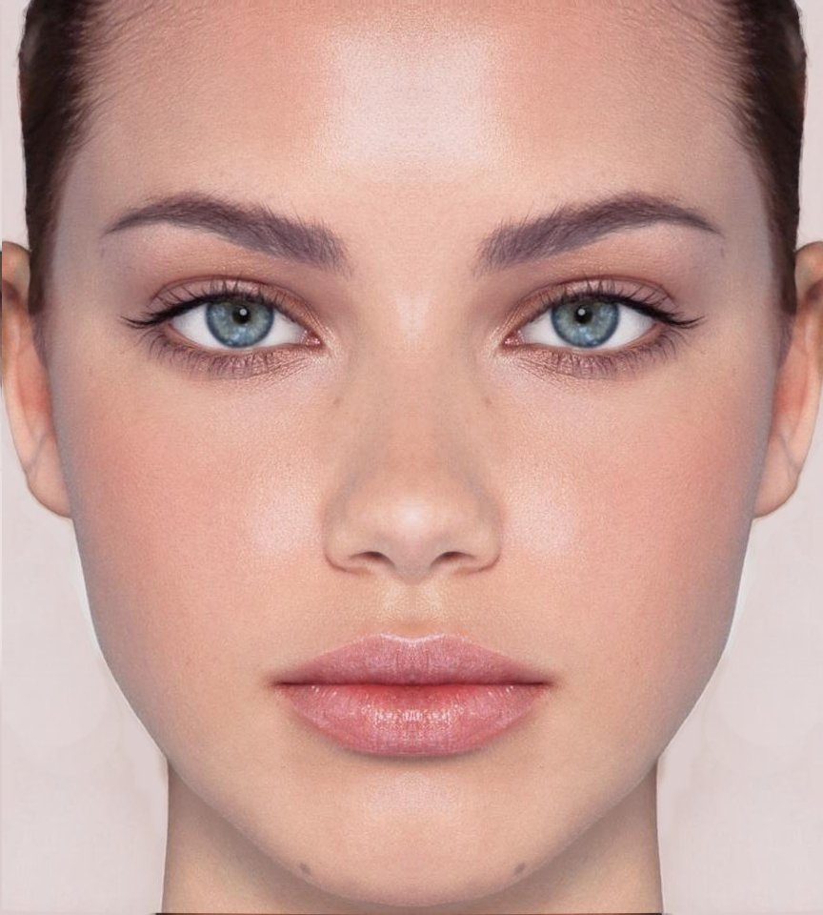
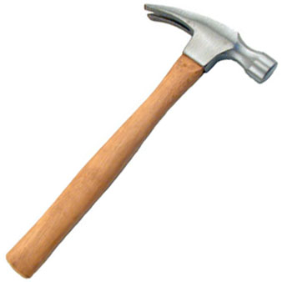


There are four types of stamps that you may find. They will have pictures of either faces, places, tools, or animals (as shown below). Each type of stamp leads to either gaining or losing a different amount of points.
Press the ’Spacebar’ to continue.

Slide 4
On the next screen, you will be shown the number of points that correspond to each stamp. Negative values (e.g. -4) mean you lose that many points. You will need to memorize this information, and you will be tested on it on the next few screens. You must answer them all correctly in order to proceed with the game. (If you get any wrong, you can view the correct answers again and retry.)
Press the ’Spacebar’ to continue.

Slide 5
Good job!
Next, you will do a short task using the values you just learned.
You will see two stamps and have to indicate which stamp is WORTH MORE (will let you gain more, or lose less) by pressing 'F' for the left stamp or 'J' for the right stamp.
You will be given feedback if you were correct and shown both stamp values.
This will help you better learn the stamp values for the main task which you will do after.
Press the ’Spacebar’ to continue.

Slide 6
Now we will continue the instructions for the main stamp-collecting game.
Press the ’Spacebar’ to continue.

Slide 7




There are four different types of machines that can give you stamps. They can be identified by the colour and shape on each machine. When you select a machine, it will give you a stamp. You will not know what stamp you'll get until you select a machine.
Press the ’Spacebar’ to continue.

Slide 8

For example, the first time you select this machine, it may give you a stamp with a tool. The second time you might get a different stamp, for example, one with an animal. Or you could get the same stamp again.
1st Selection
2nd Selection
3rd Selection
4th Selection
Press the ’Spacebar’ to continue.

Slide 9
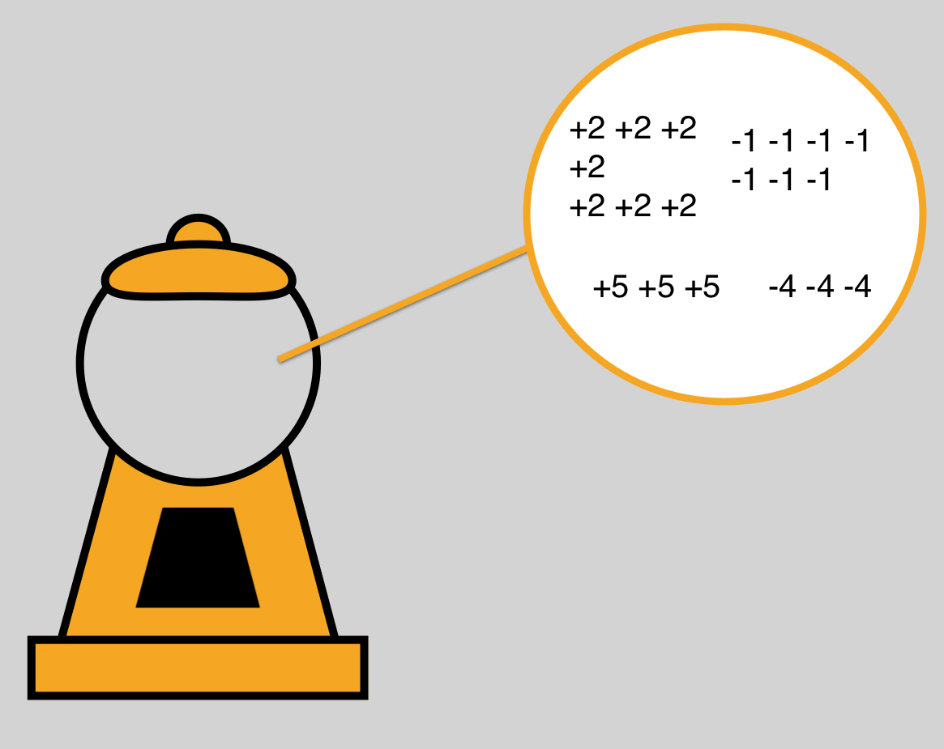
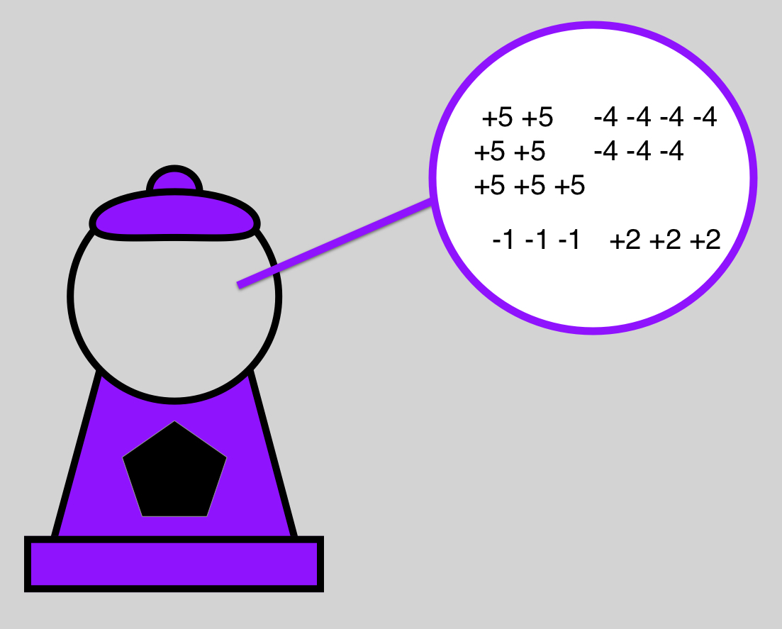
Each machine can give you any of the 4 types of stamps. However, some of the machines are more likely to give you stamps with houses (+5 points) and faces (-4 points) - for example, the purple machine shown here . Other machines are more likely to give you stamps with tools (+2 points) and houses (-1 point) – for example, the orange machine shown here. While playing, you will have to figure out which machines are more likely to give you which types of stamps. Note that, over the long run all the machines will give you the same amount of points. The only difference is in which types of stamps are more likely .
Not used
Press the ’Spacebar’ to continue.

Slide 10
You are done the practise. For the main game, on each turn, you will see 2 machines. You will have to choose which one you would like to receive a stamp from. You will then be shown the stamp you got from that machine. Press the "F" key to select the left machine, and the "J" key to select the right machine. This time, please select the right machine.
Press “J” to select the right machine.

Slide 11
This time, please choose the left machine.
Press the “F” key to select the left machine.

Slide 12

After you select a machine, the stamp you received will appear for a few seconds. For example, this time you got a face stamp. After you see the stamp, the game will automatically advance to the next turn (you will not have to press anything).
Press the ’Spacebar’ to continue.

Slide 13
Remember, in this game your goal is to gain as many points as possible by collecting different types of stamps. You will earn bonus payment after the task based on how much you earn in the game! Now you can begin the game. It will take approximately 3-4 minutes.
Press the ’Spacebar’ to continue.

Slide 14
MEMORY TEST
Before continuing, we want to make sure you remember how many points each type of stamp gives you or takes away.
On the following screens you will see one image of a stamp. Please type in its value and press enter. (For example, type in “-4” for losing 4 points.)
If you answer incorrectly, you will be shown the points associated with each type of stamp again, and can try the test again.
Once you answer them all correctly, you may proceed with the study.
Not used
Press the ’Spacebar’ to continue.

Slide 15
To help you learn about the machines, you will now have some practise trials. A machine will appear onscreen, and then you will have to press the spacebar to see what stamp it gives you. Use this time to learn about what kind of stamps tend to come from each machine. This part will take about 3-4 minutes
Press the ’Spacebar’ to begin.

